Slide 1
JOURNEY SCRAPBOOK
Custom-IDA Bootcamp 2023
29th August 2023 to 5th October 2023
WEEK 6

Slide 2
DAY 18: PySpark Day 3

Slide 3
Topics Covered
Spark as ETL/Optimizations
3 modes of Dataframe reader and writer
Data cleaning and subsetting
Filtering Data frame
Handling null values
Transformations operations on data
Reading data from different data sets
Clean and transform the data

Slide 4
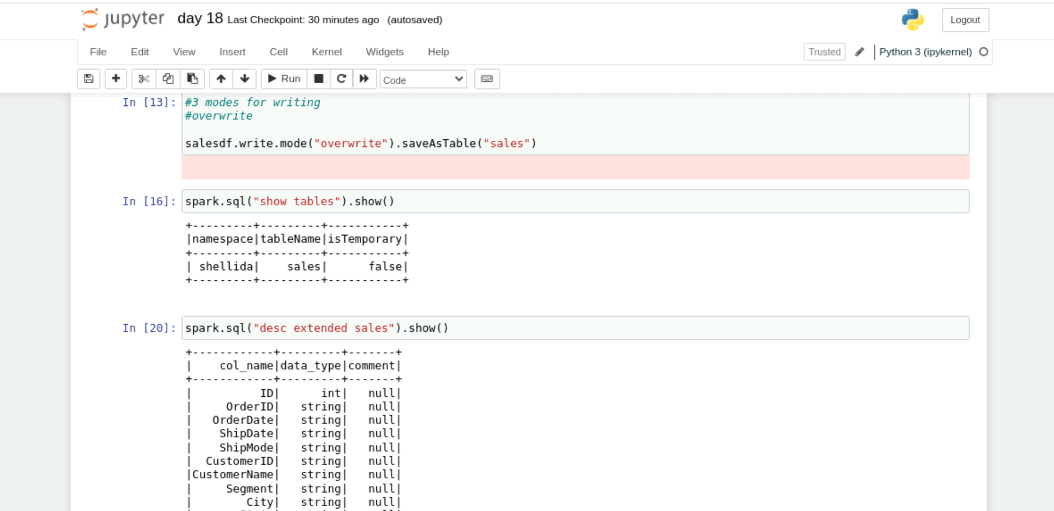
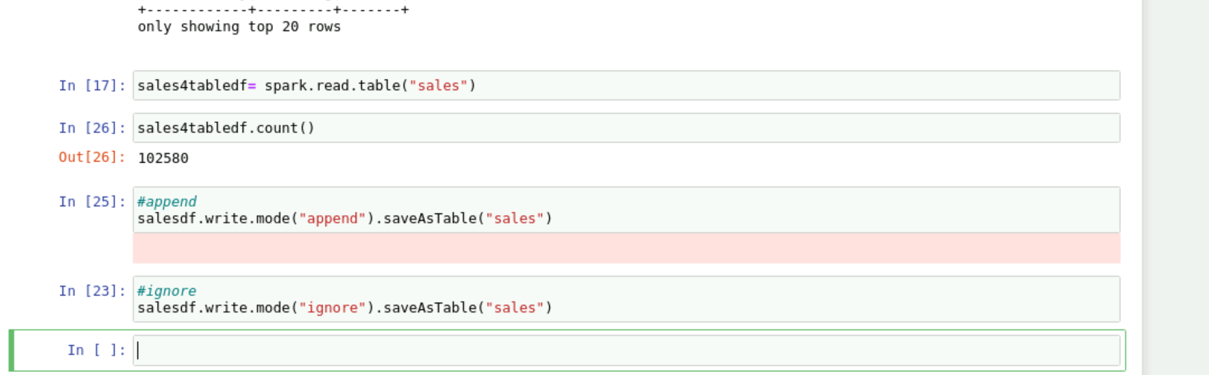
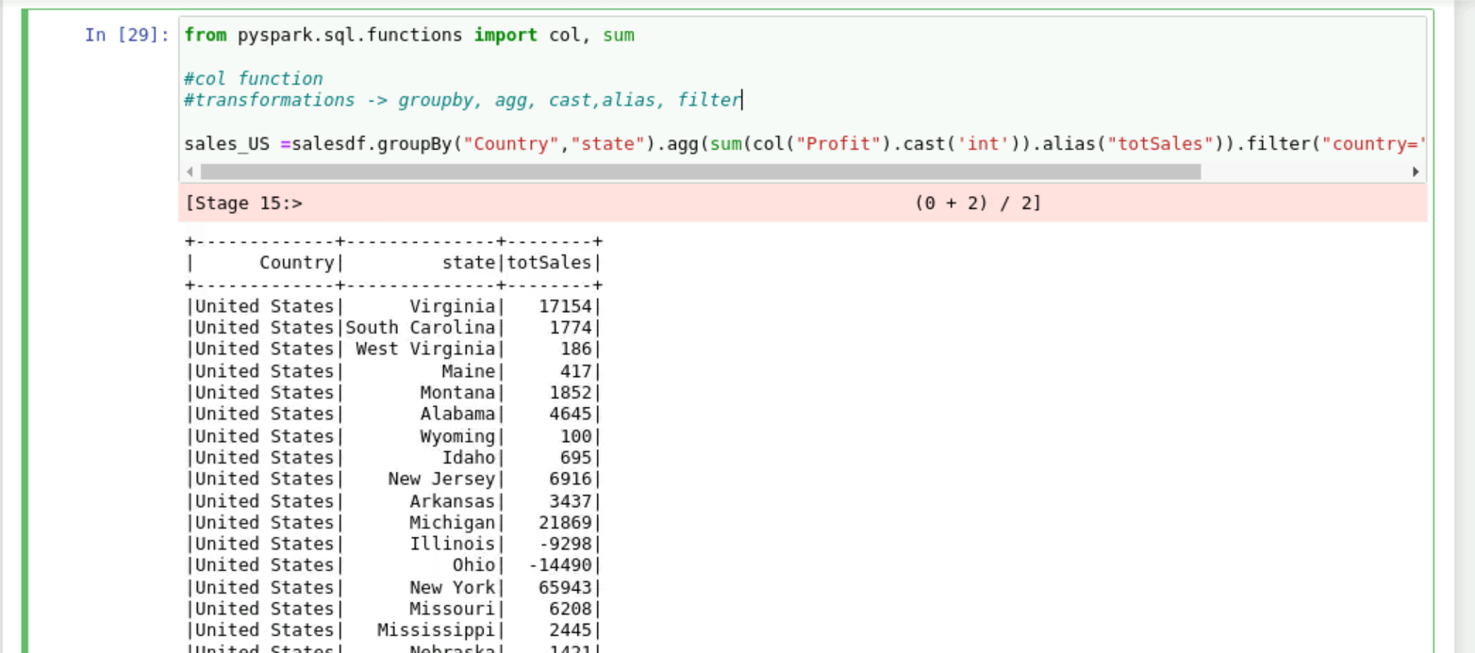
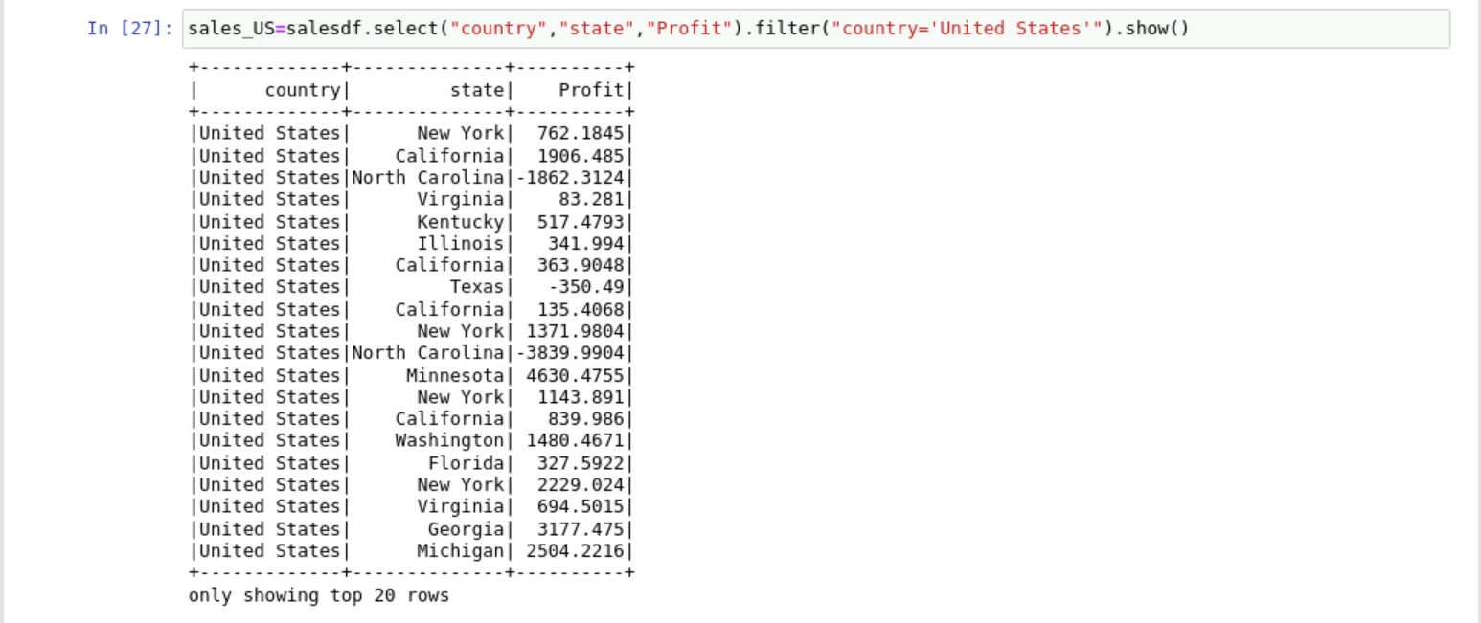

Slide 5
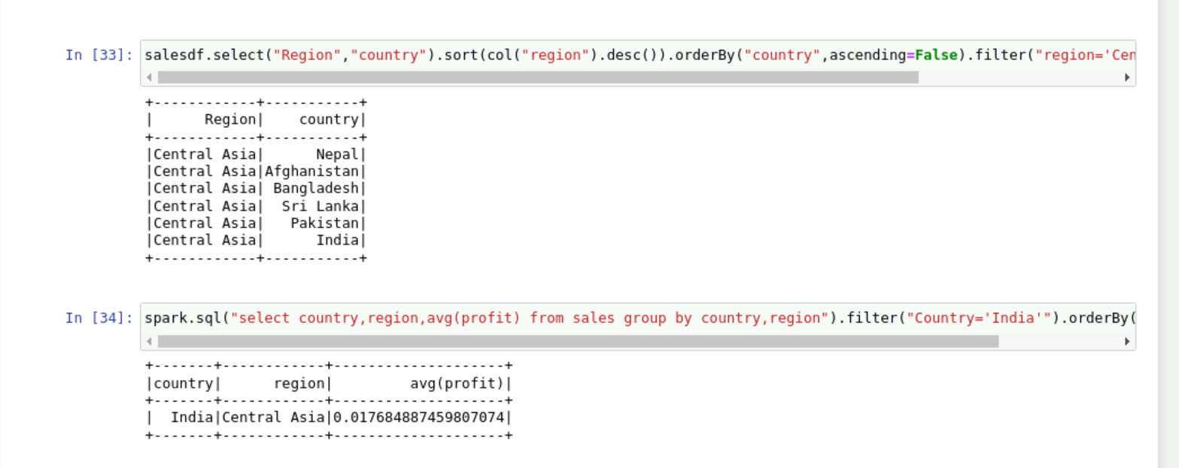
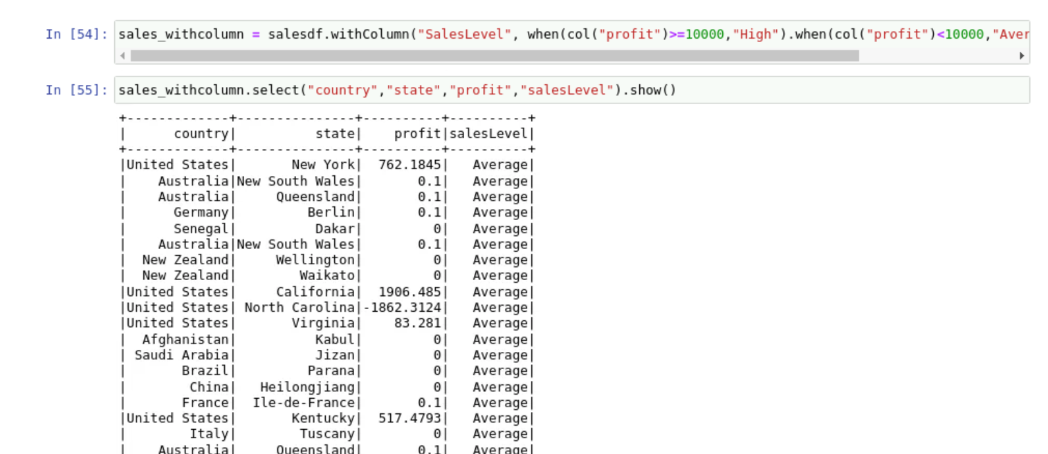
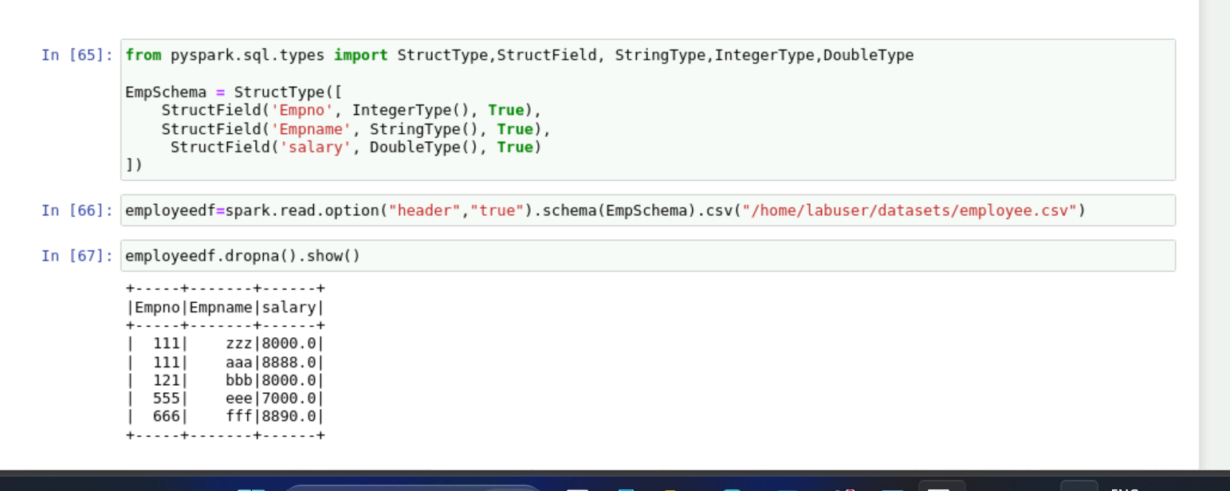
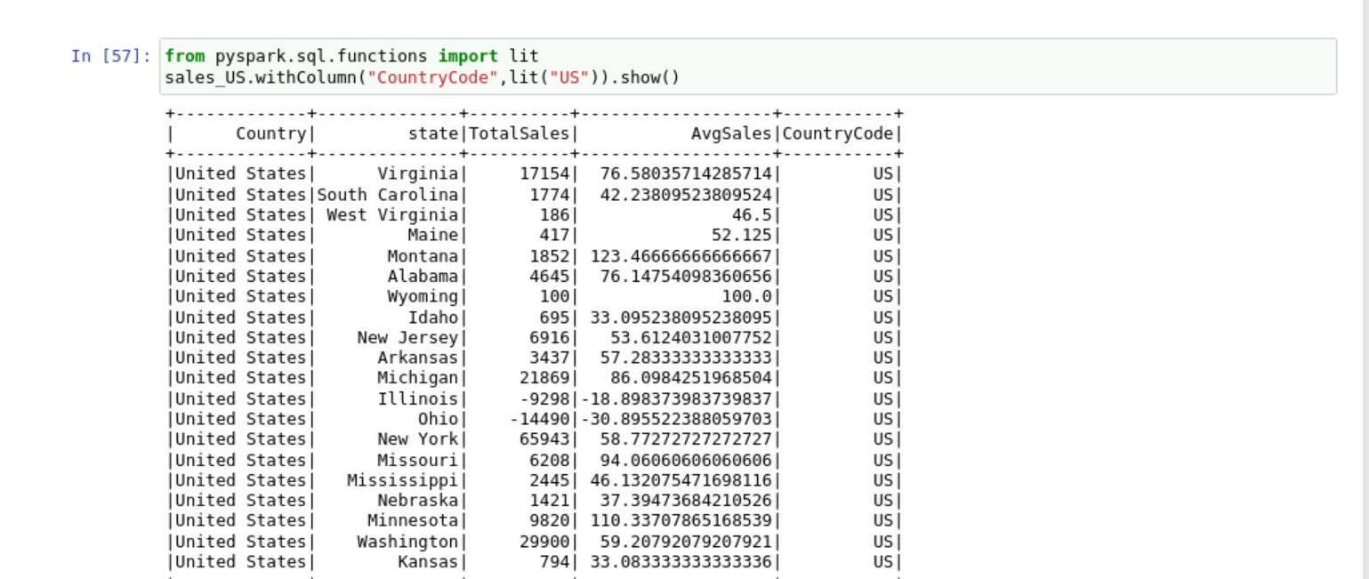

Slide 6
DAY 19: Azure Databricks Day 1

Slide 7
Topics Covered
Databricks Overview: Introduction, Architecture
Computation management: Types of Databricks clusters
Concept of DBFS
Azure data bricks using PySpark and SparkSQL
File handling in Data bricks
Accessing blob or ADLS
Mounting ADLS in DBFS(mounting with SAS, Access key, Key vault)
Batch vs Streaming data

Slide 8
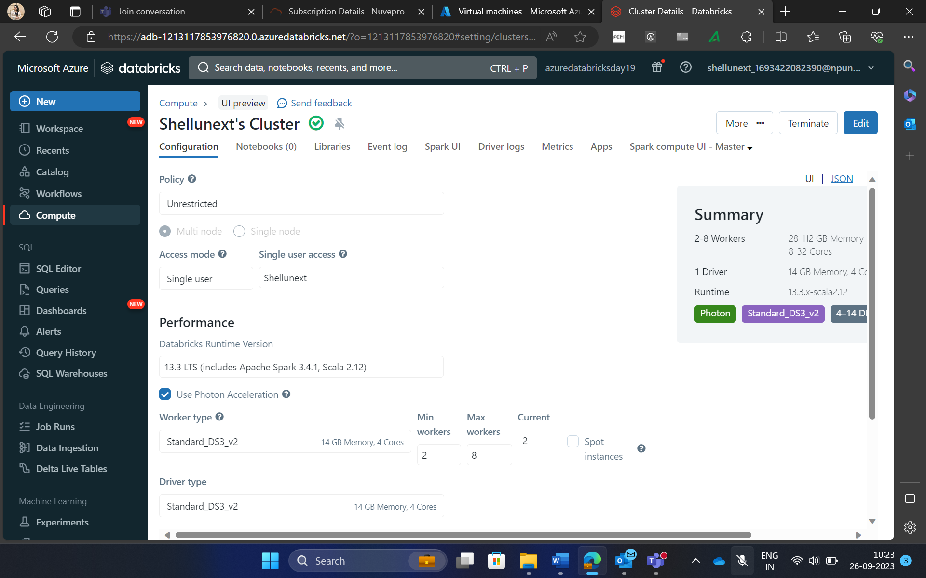
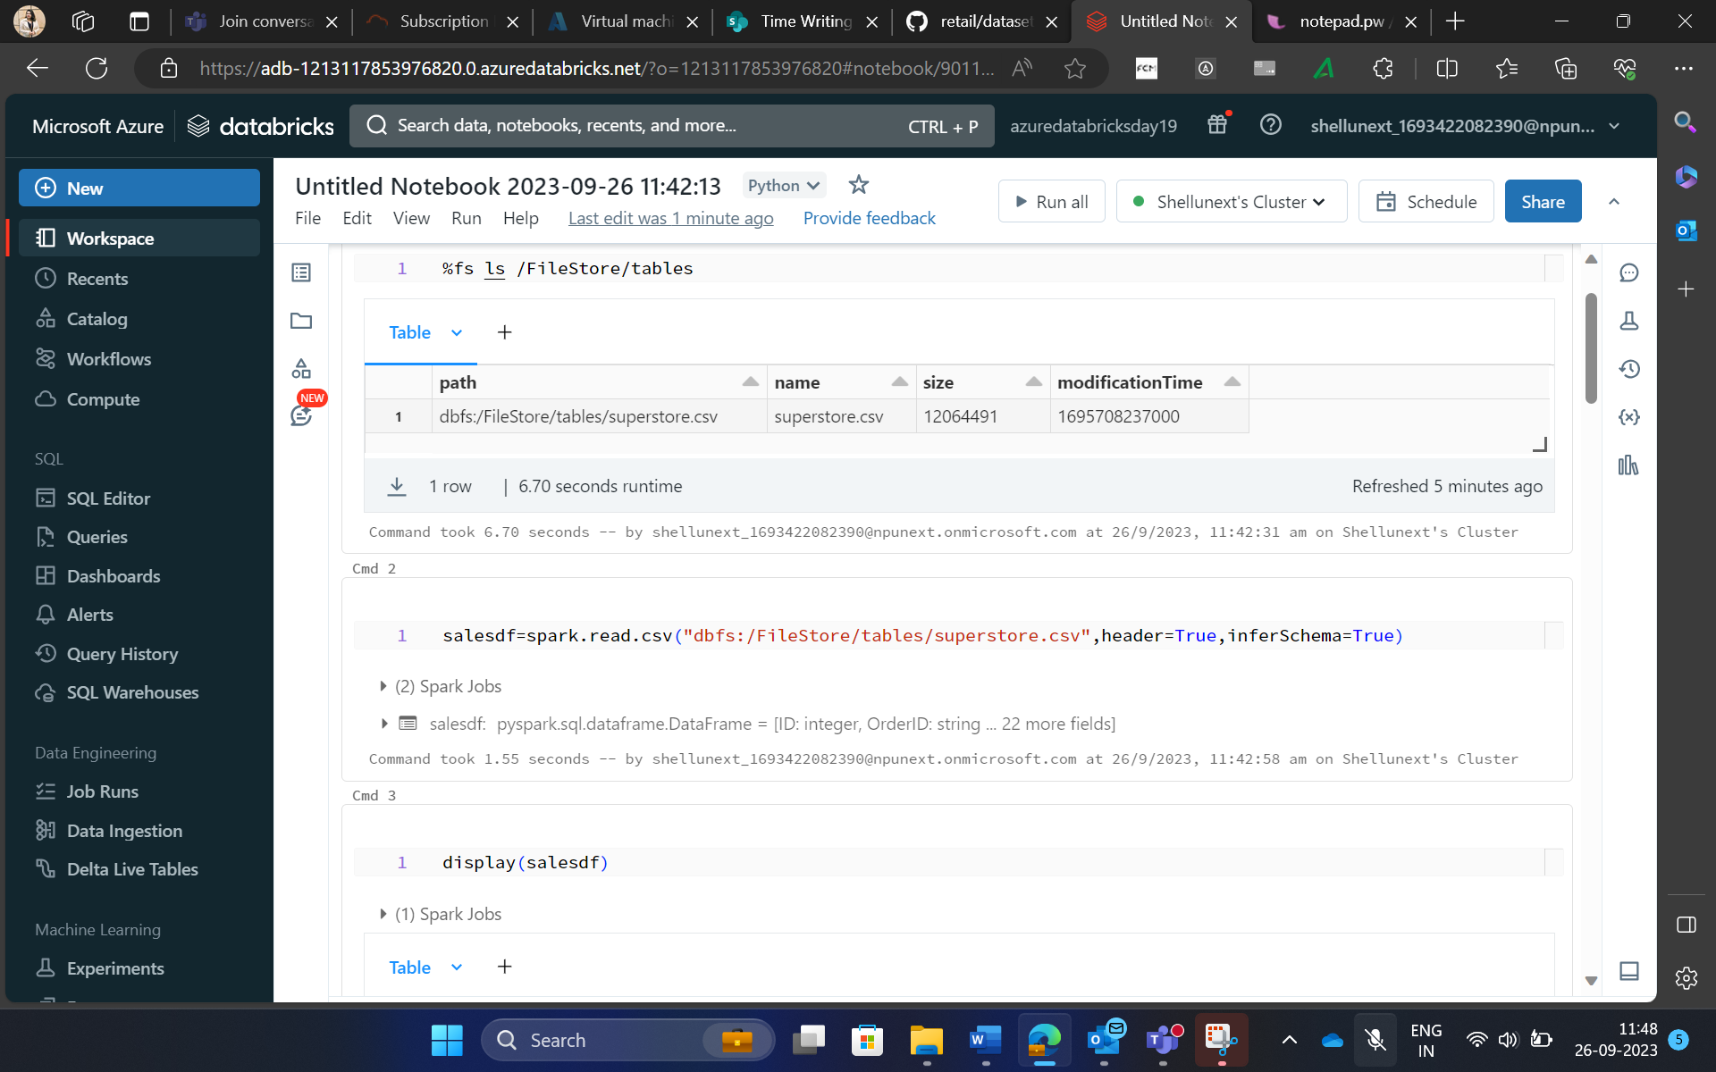
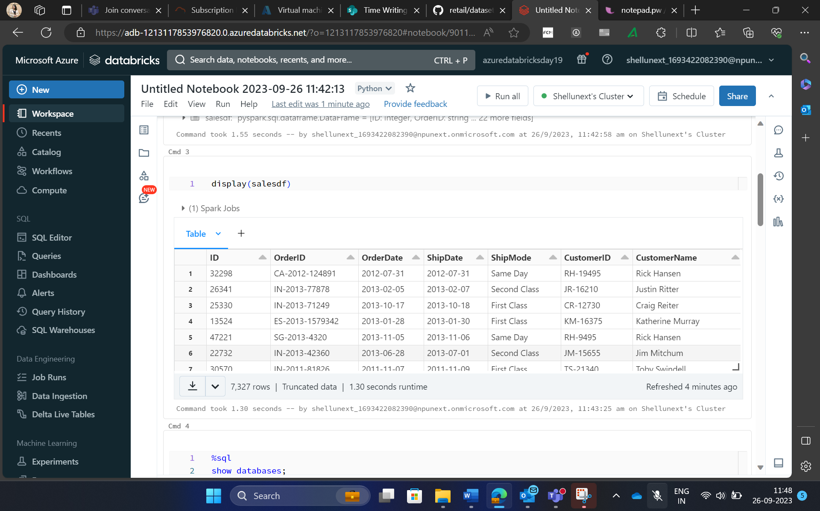
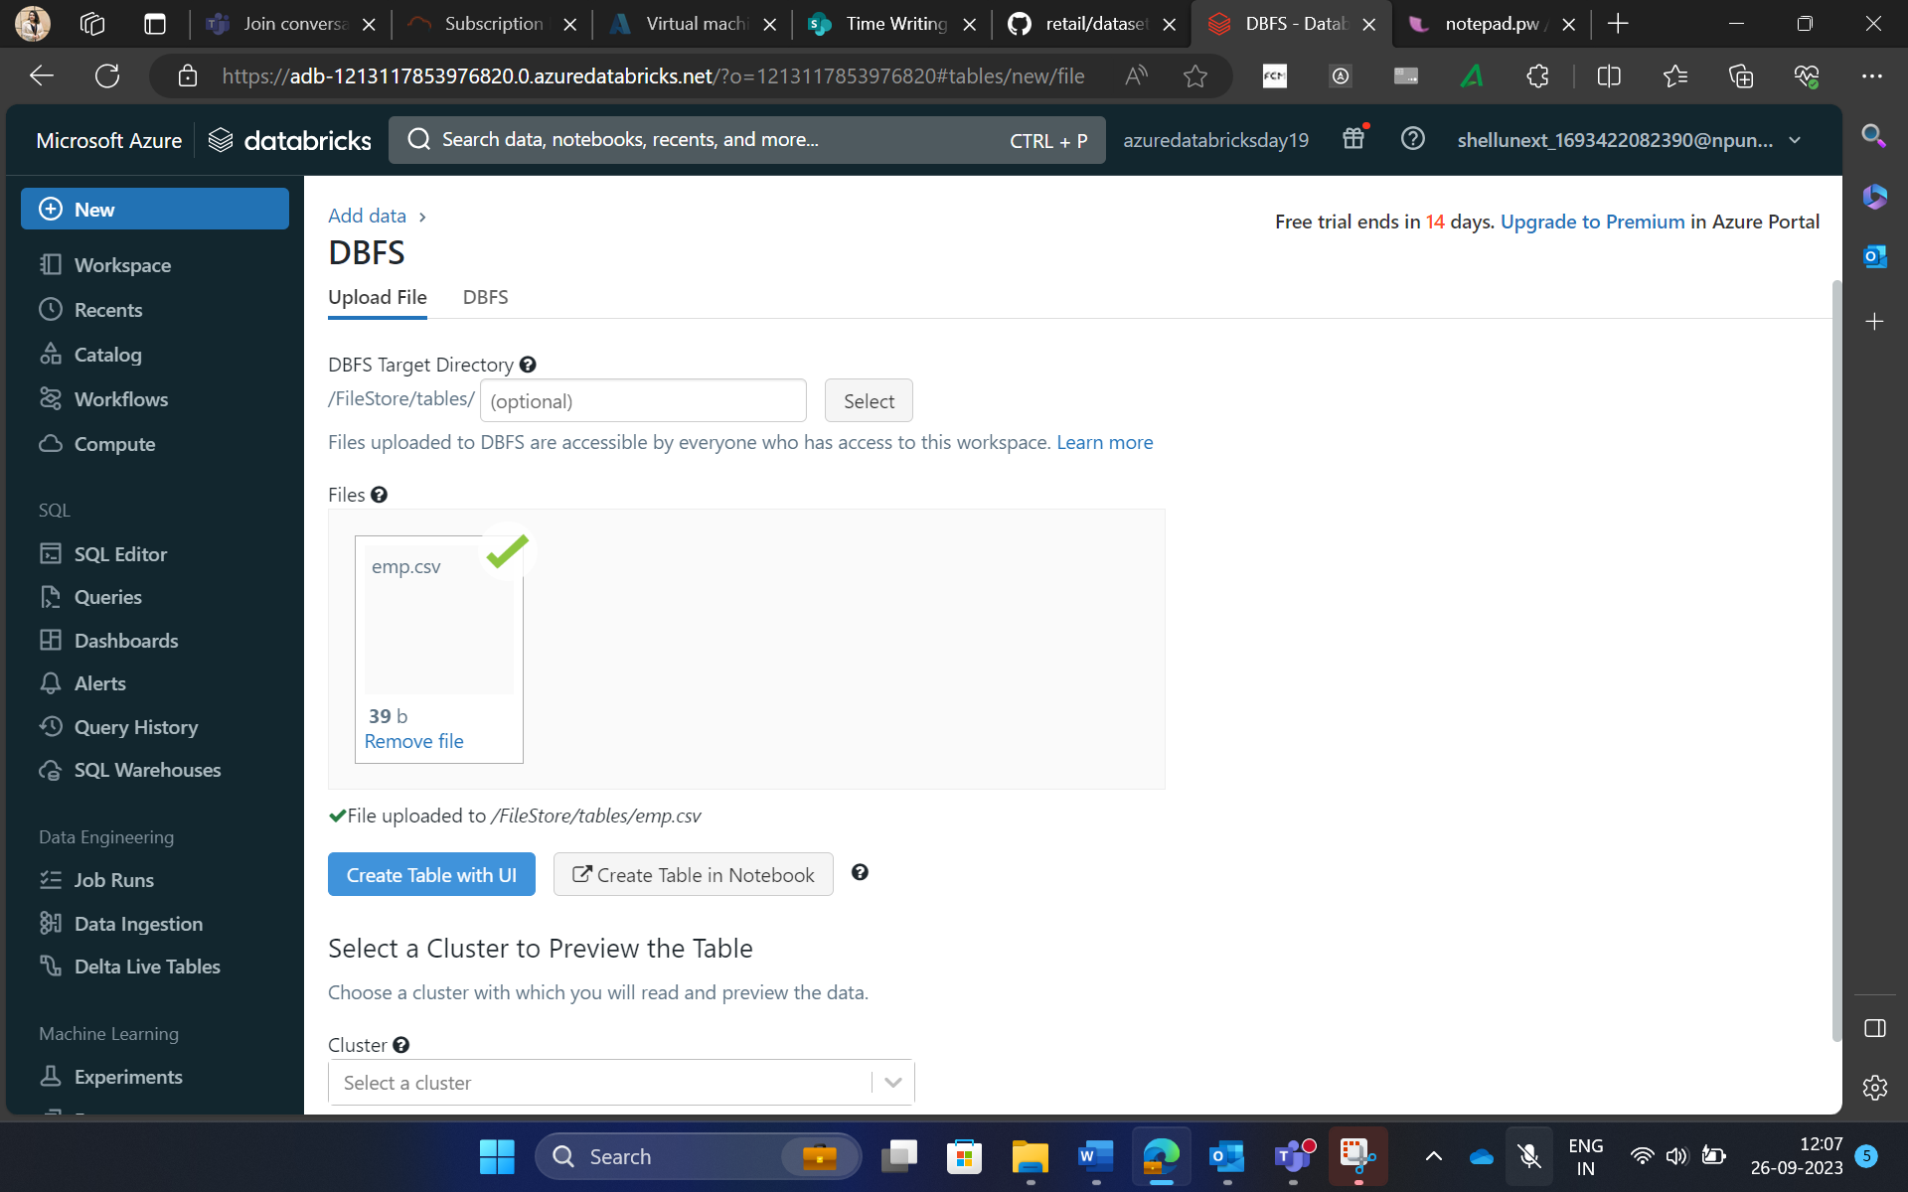

Slide 9
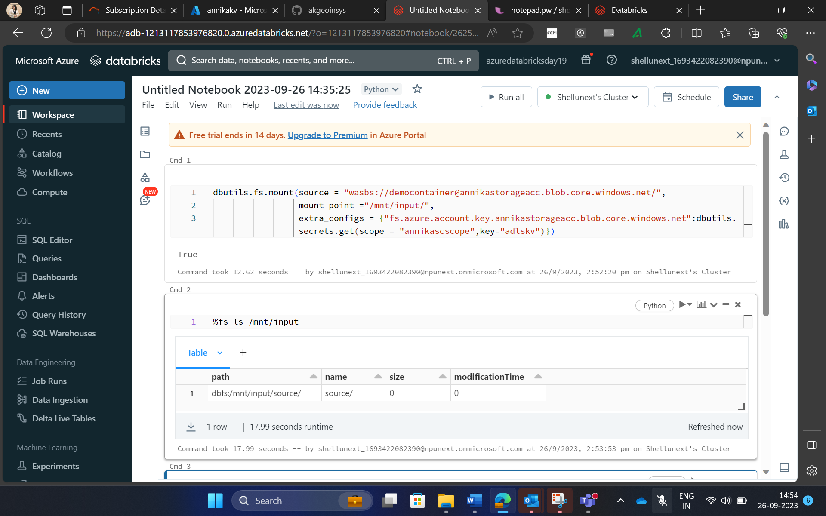
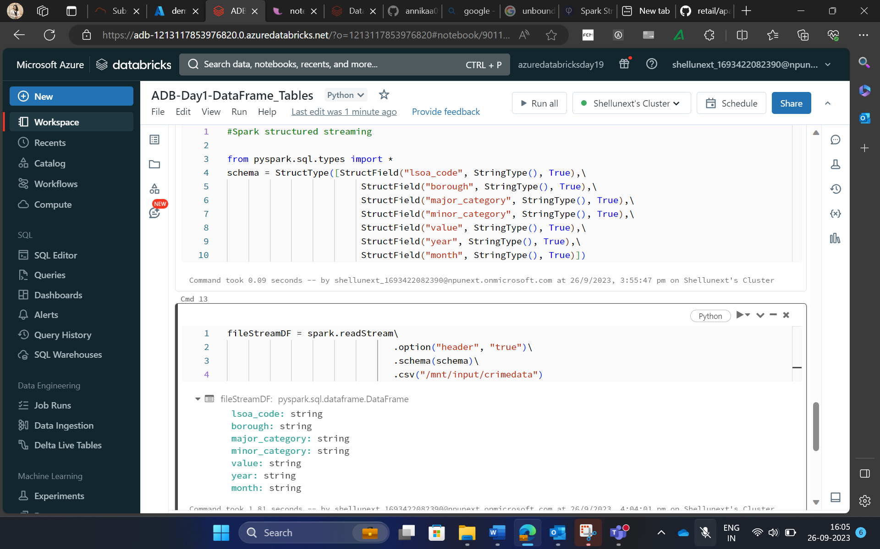
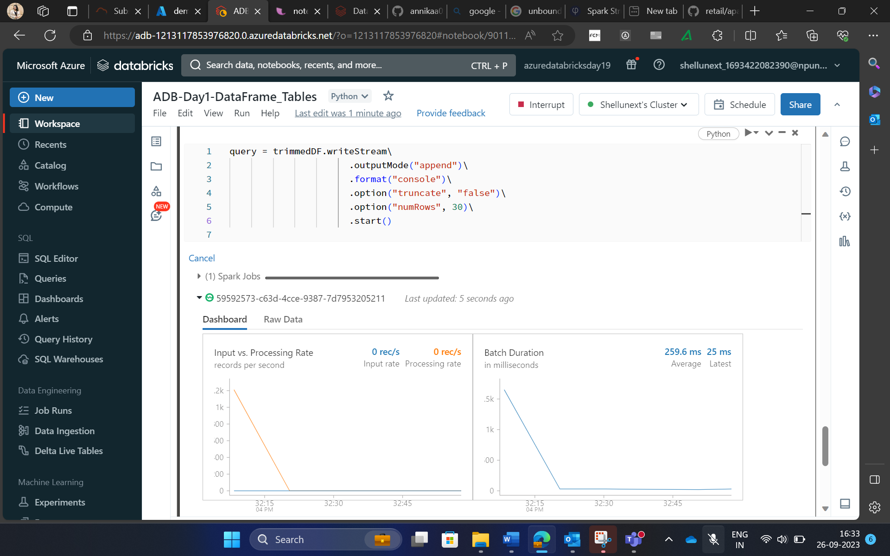
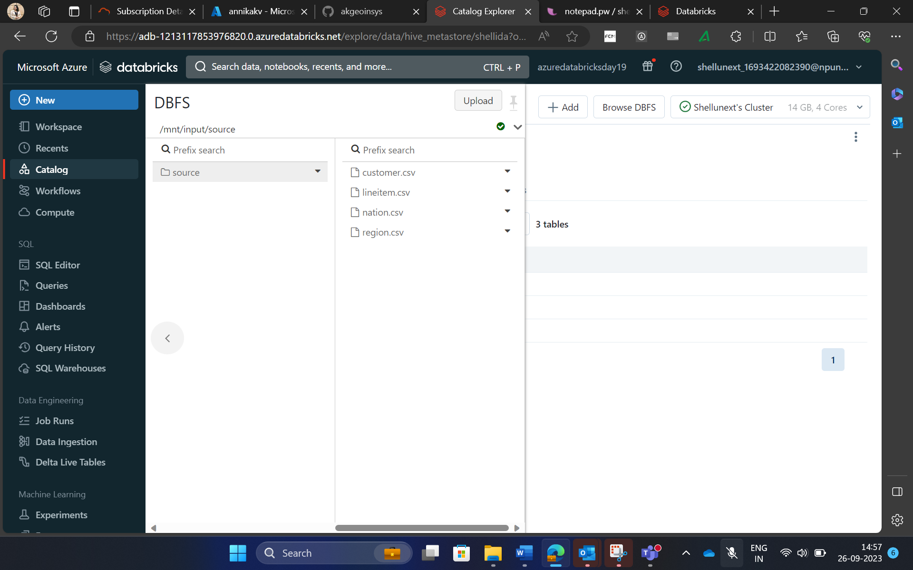

Slide 10
DAY 20: Azure Databricks Day2

Slide 11
Topics Covered
ADB Integration with other services(Synapse, Azure SQL DB etc)
Delta Lake Concept
Scheduling jobs(databricks jobs, calling notebook in ADF)
JDBC Connections
Creating pipeline in the workflows
Creating various widgets(dropdown, textbox, combo)
Overview of Azure Data bricks Unity Catalog
Hands-on lab practise on the topics

Slide 12
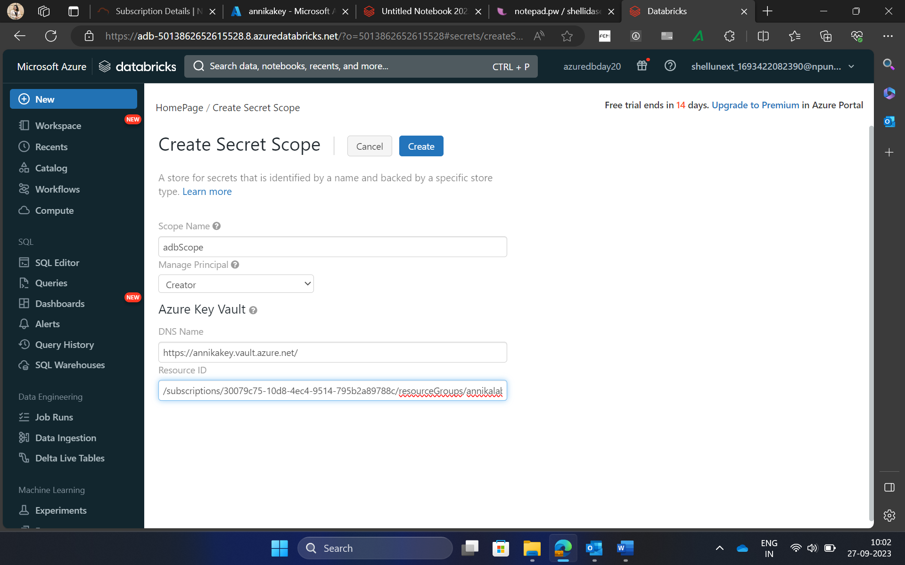
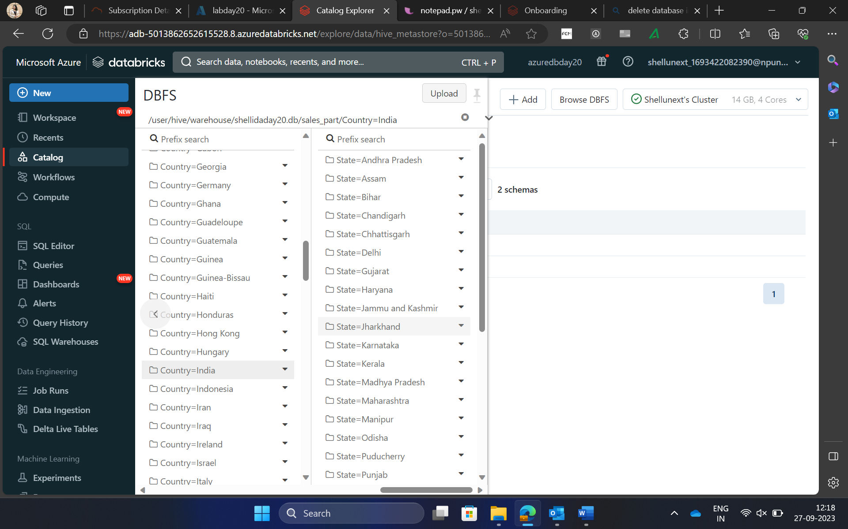
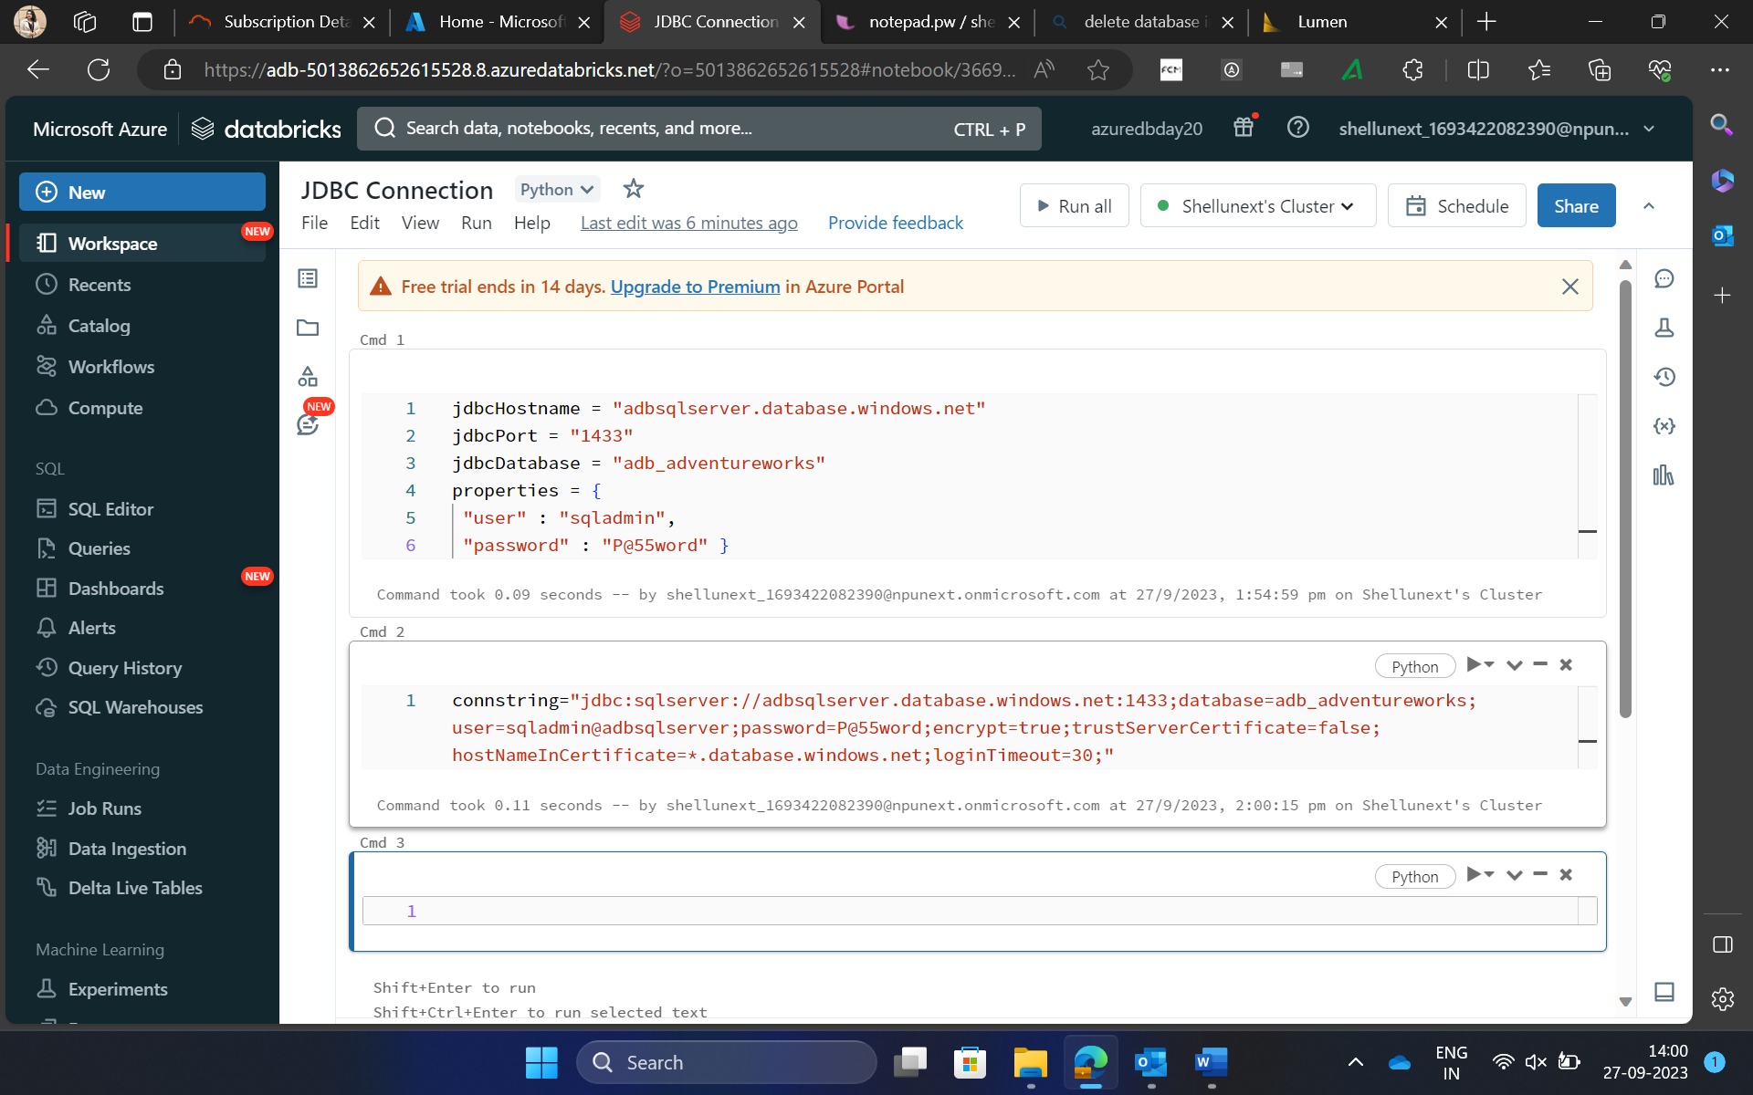
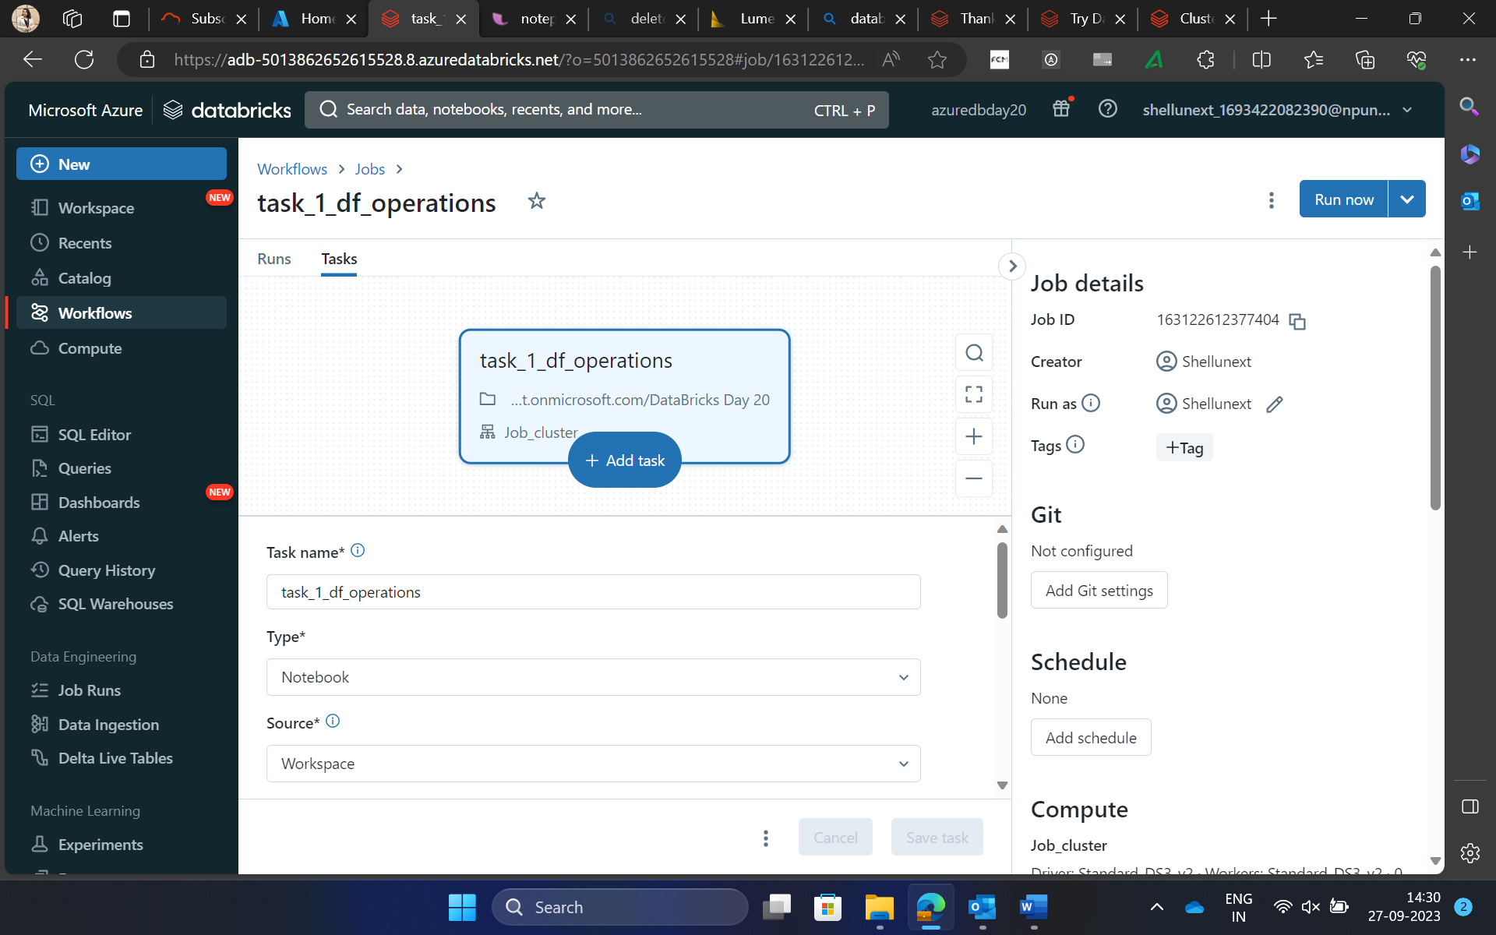

Slide 13
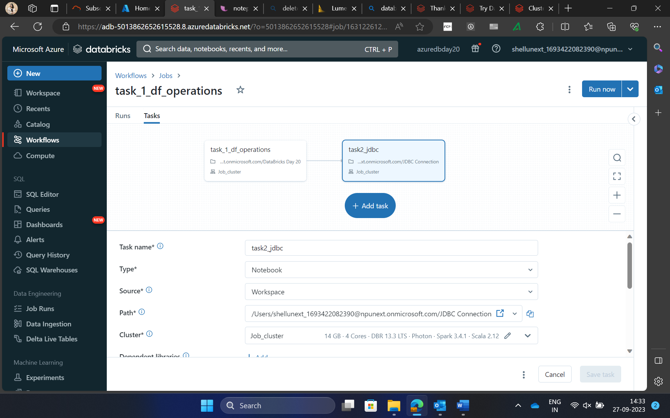
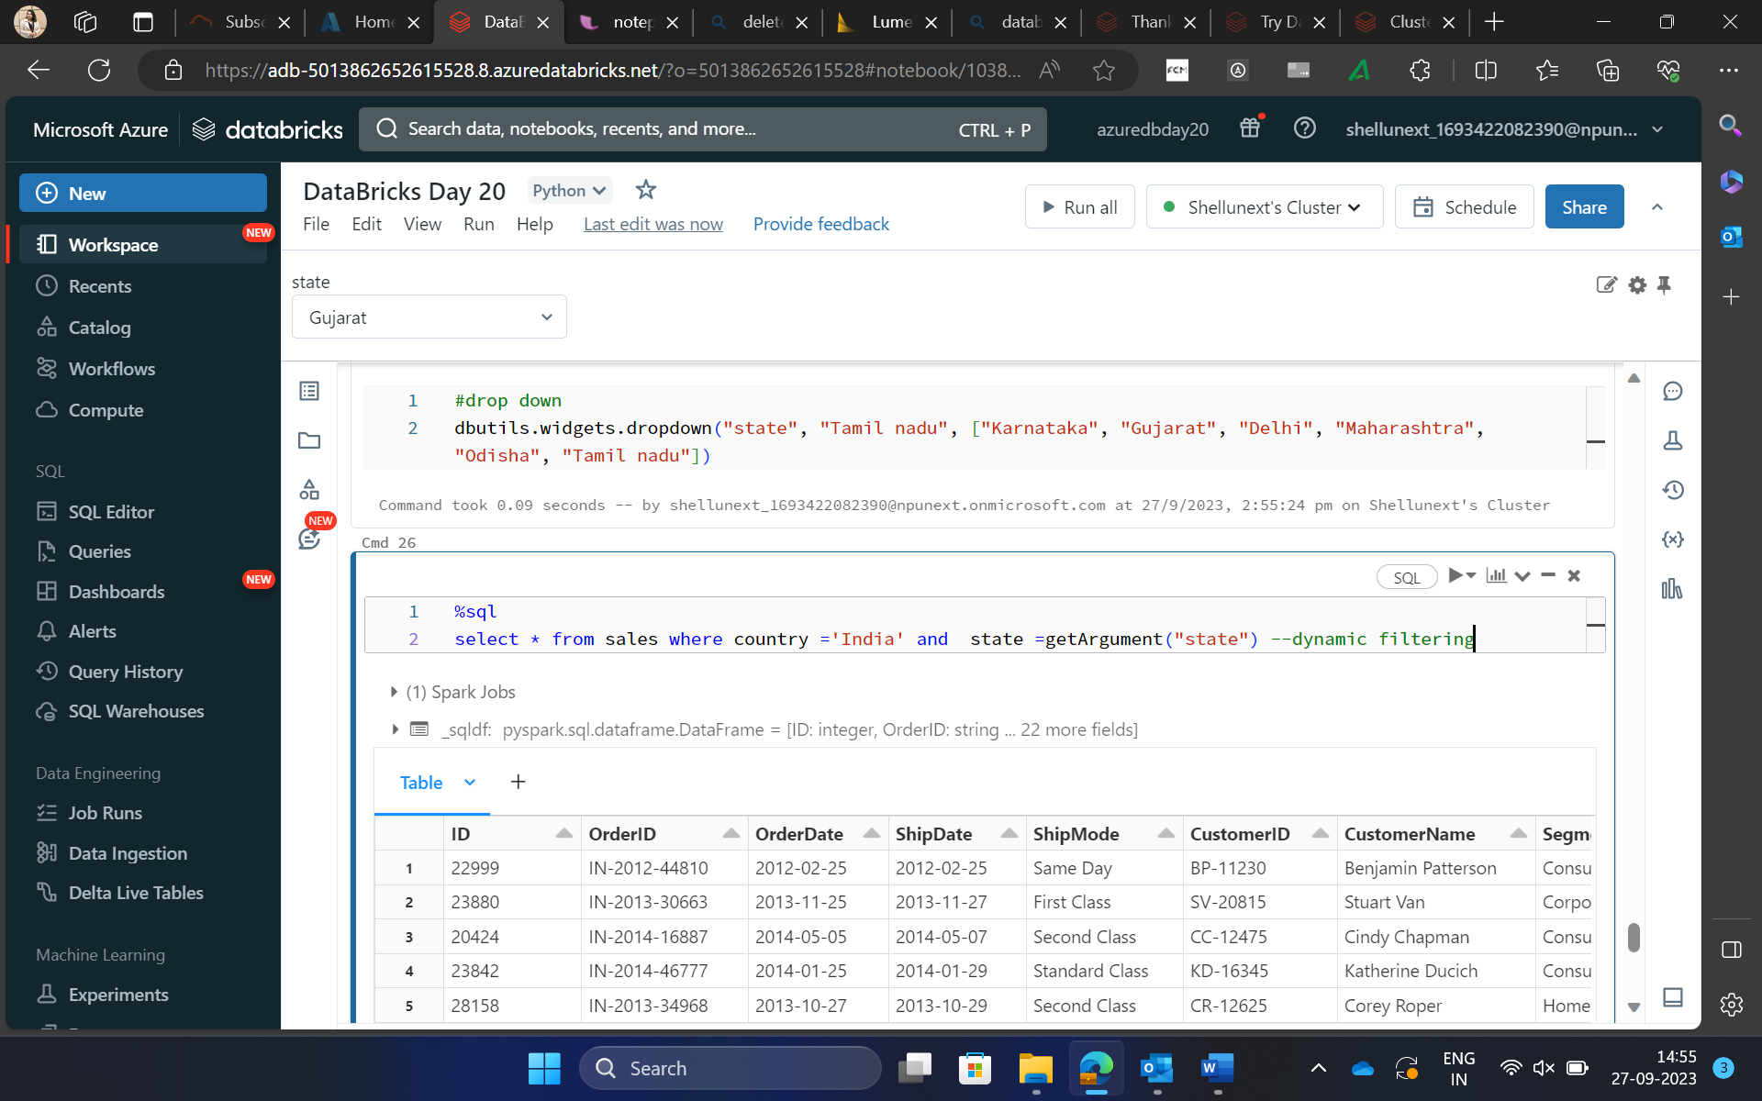
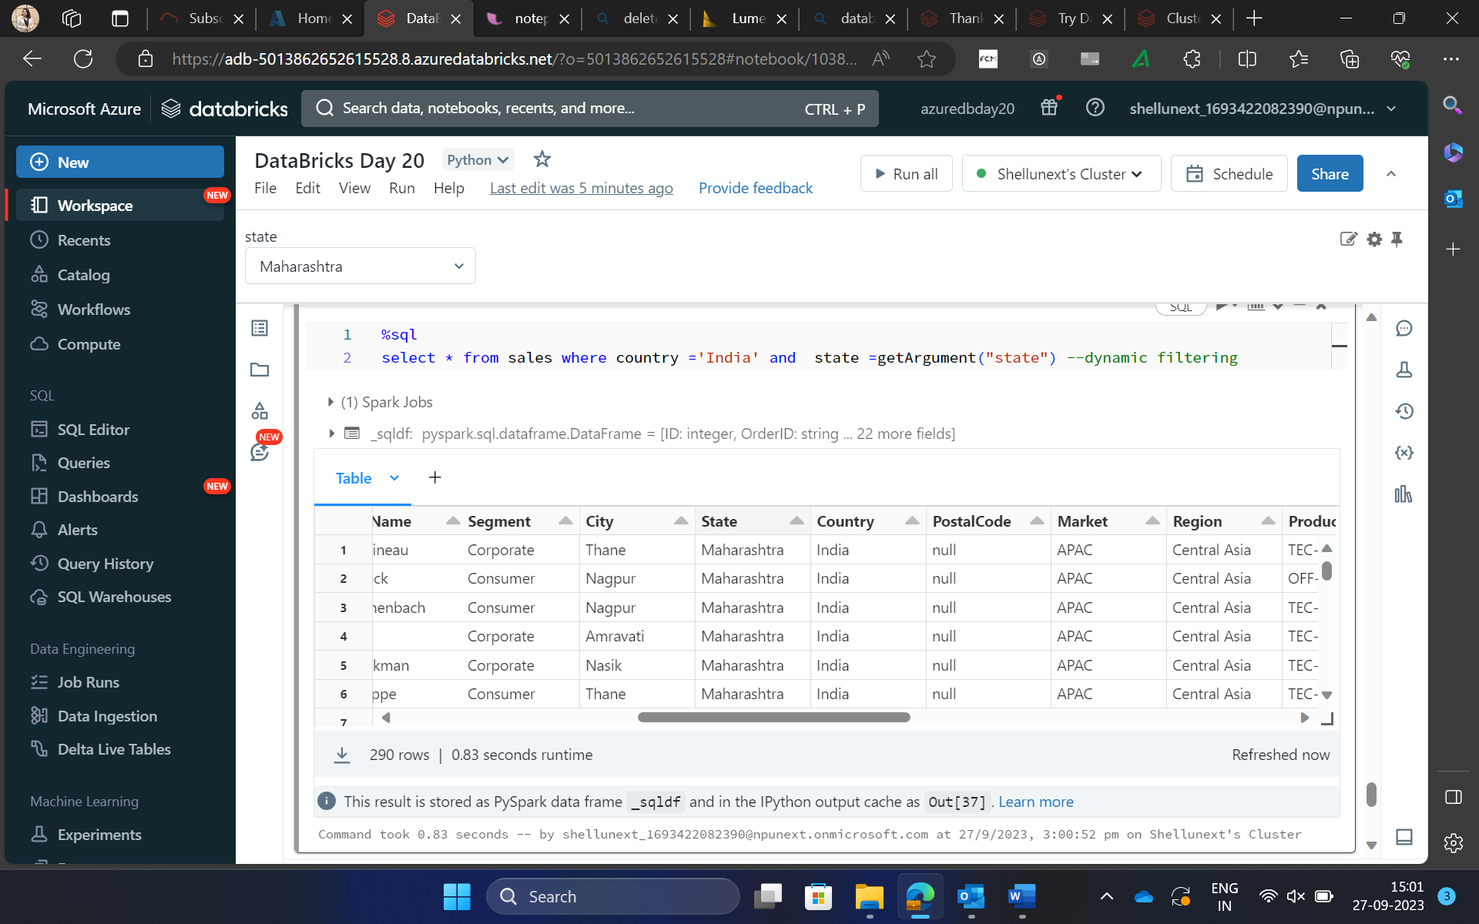
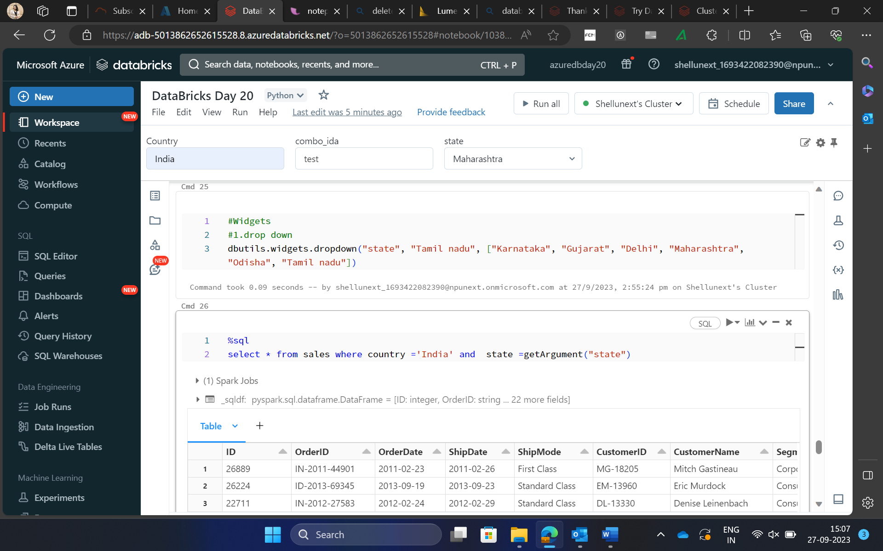

Slide 14
DAY 21: Azure Containers

Slide 15
Topics Covered
Introduction to Docker
Docker Containers, Working of Docker, Docker Image
Building Docker image
Azure Container Registry
Introduction to Azure Container Instances, running Azure container instances
Introduction to Kubernetes- how Kubernetes deployment works
What is Azure Kubernetes services

Slide 16
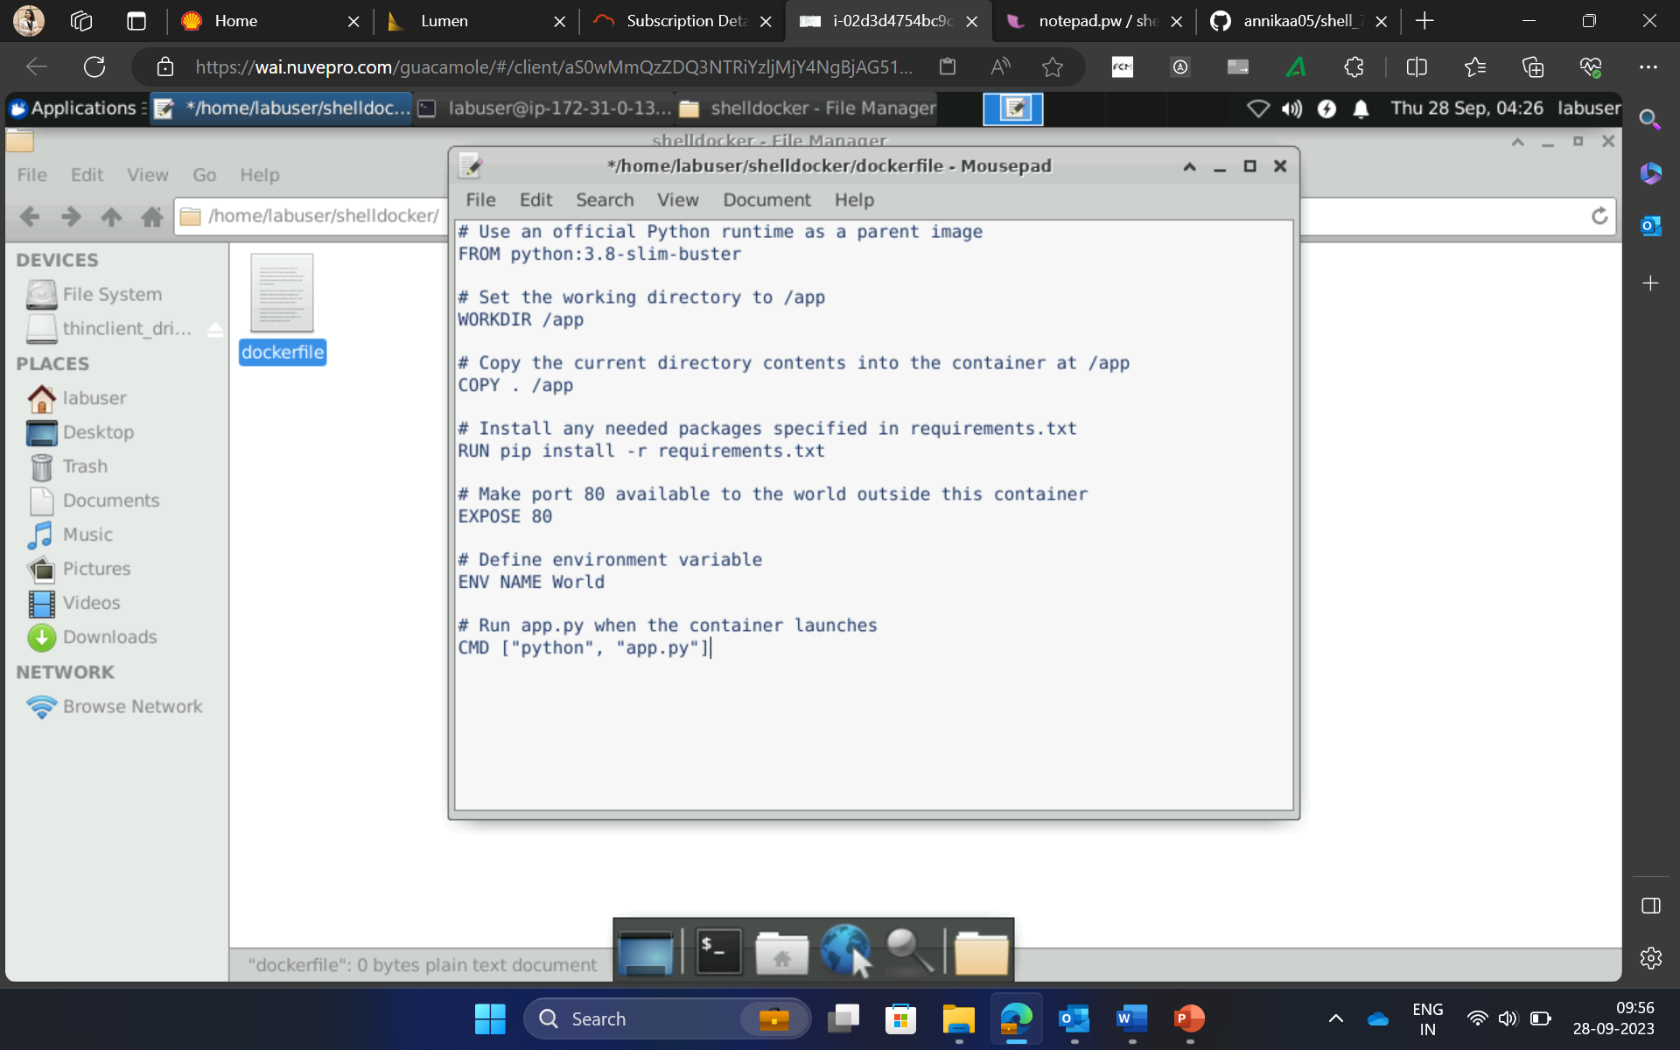
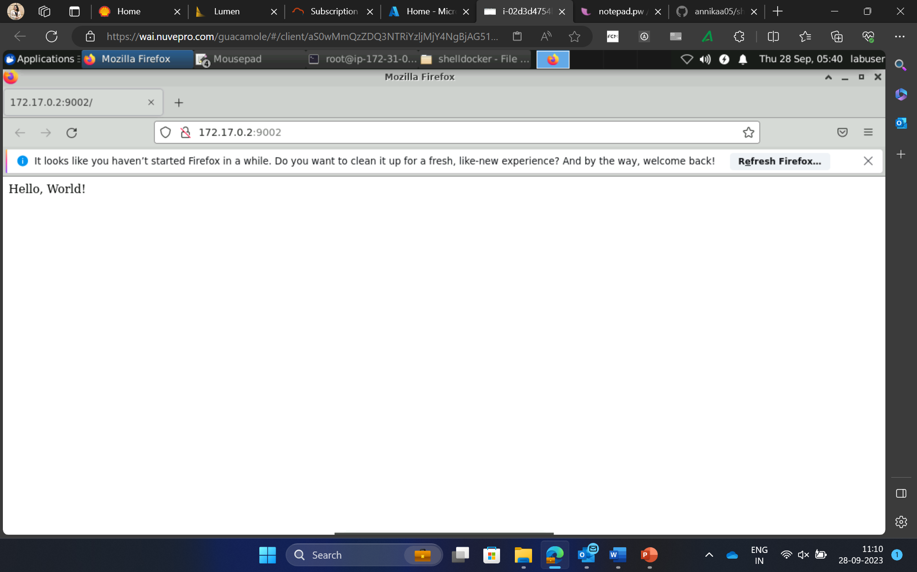
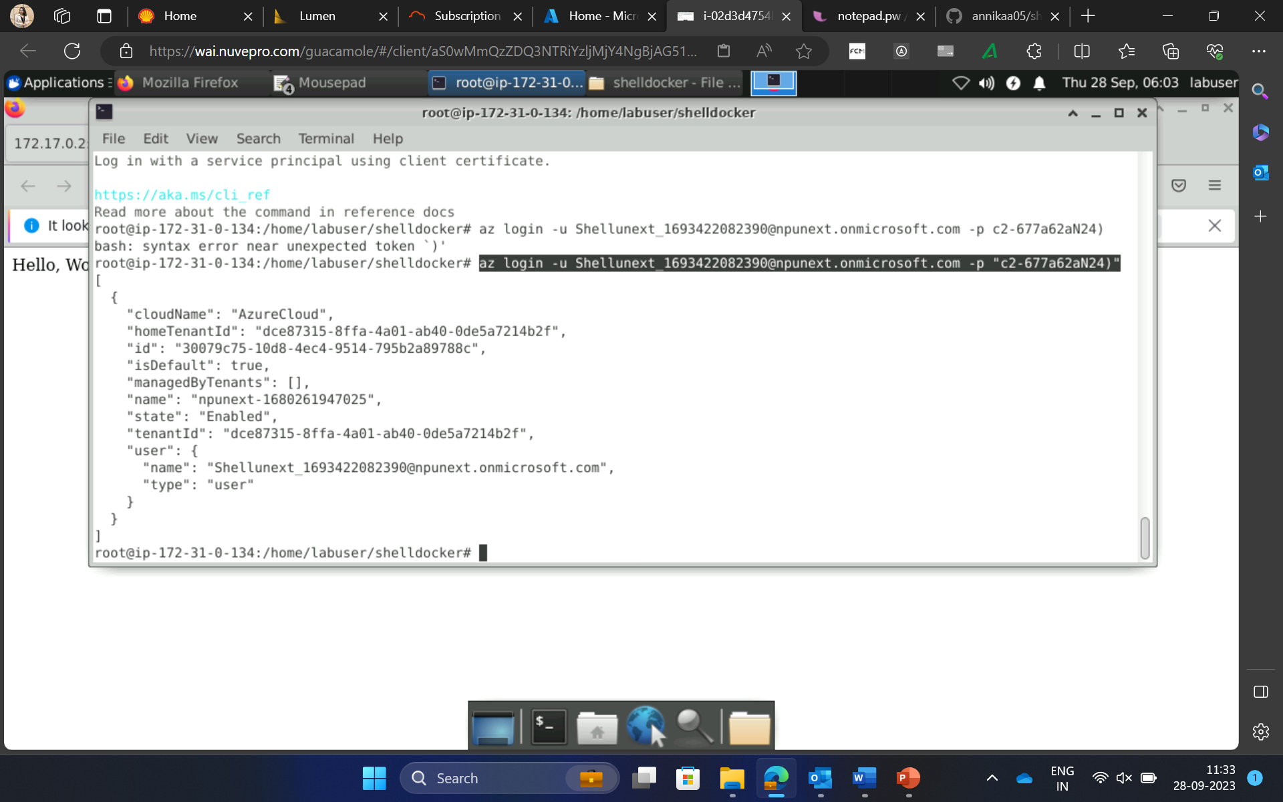
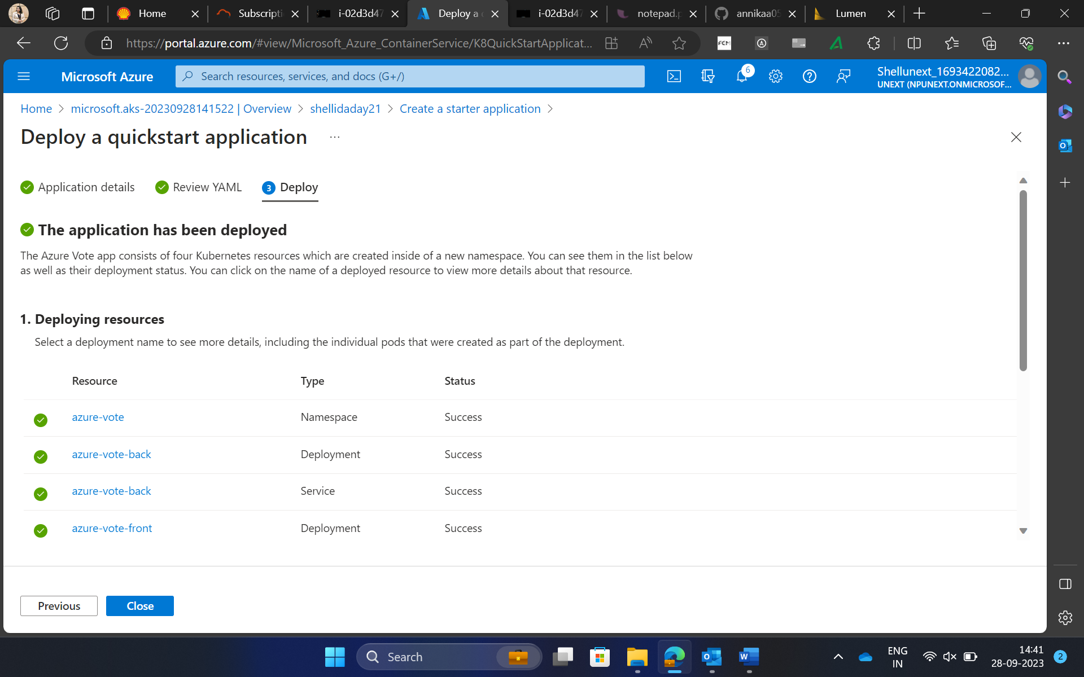

Slide 17
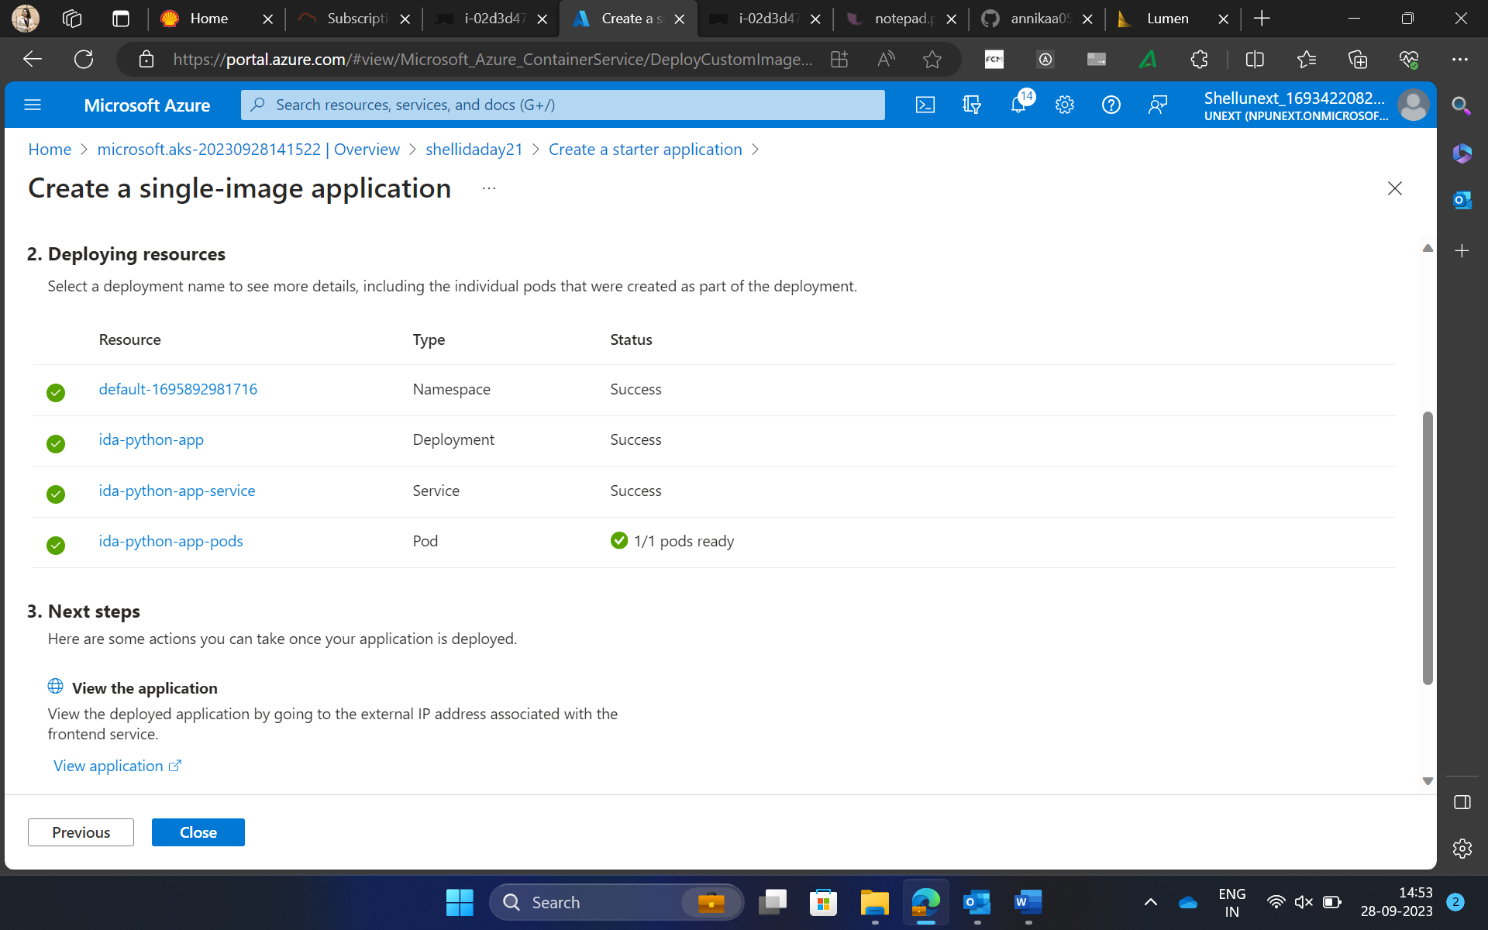

Slide 18
DAY 22: Azure Deployment/ DevOps

Slide 19
Topics Covered
Introduction to Azure Deployment and Devops
Devops Architecture
Introduction to CI/CD
Overview of Devops and Github as Devops platforms
Github actions for Build and release pipelines
Creating Azure pipelines
What is YAML ?
Implementing CI/CD with Github actions

Slide 20
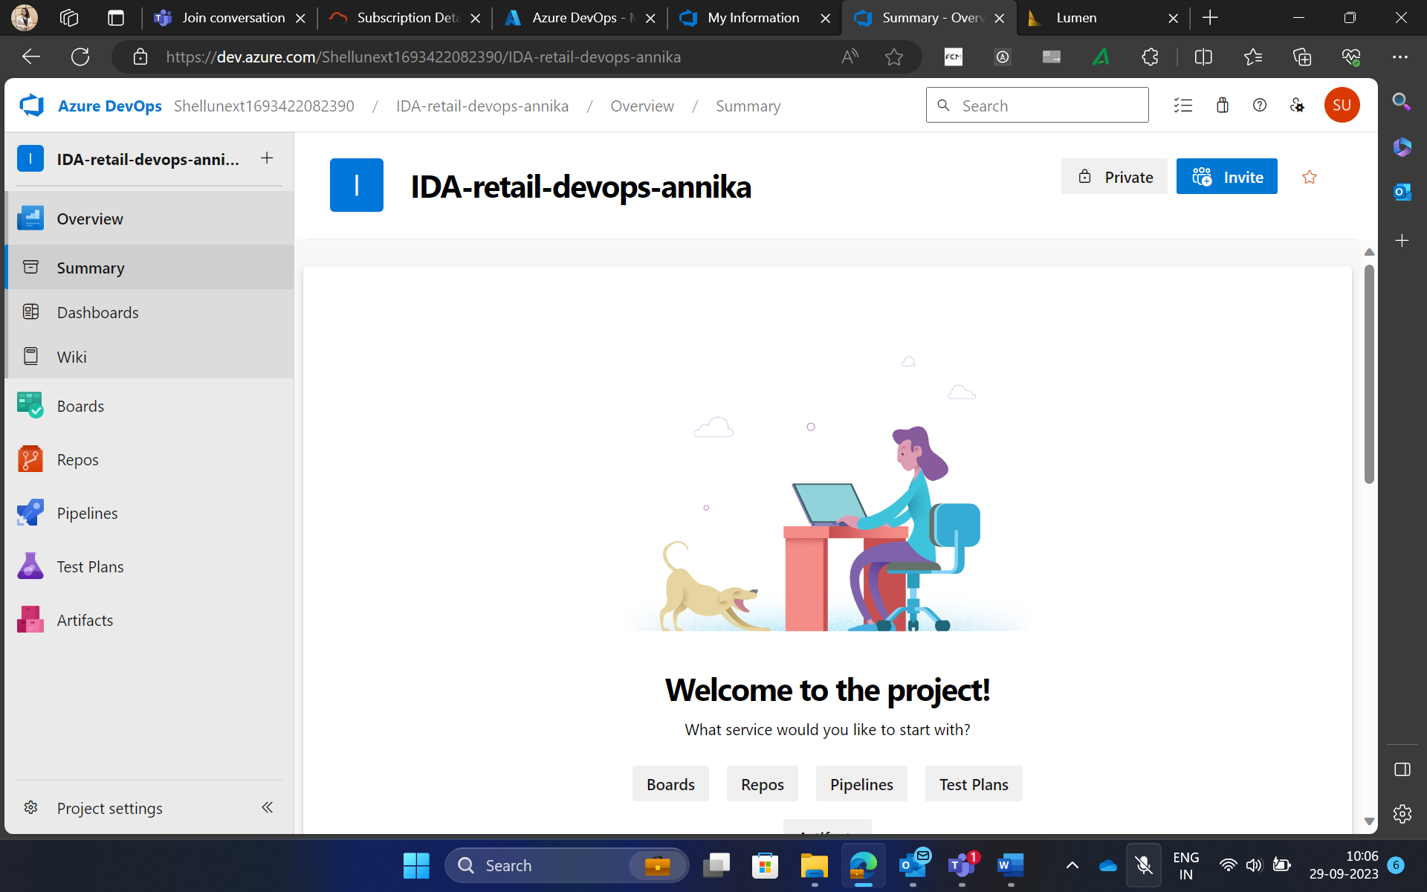
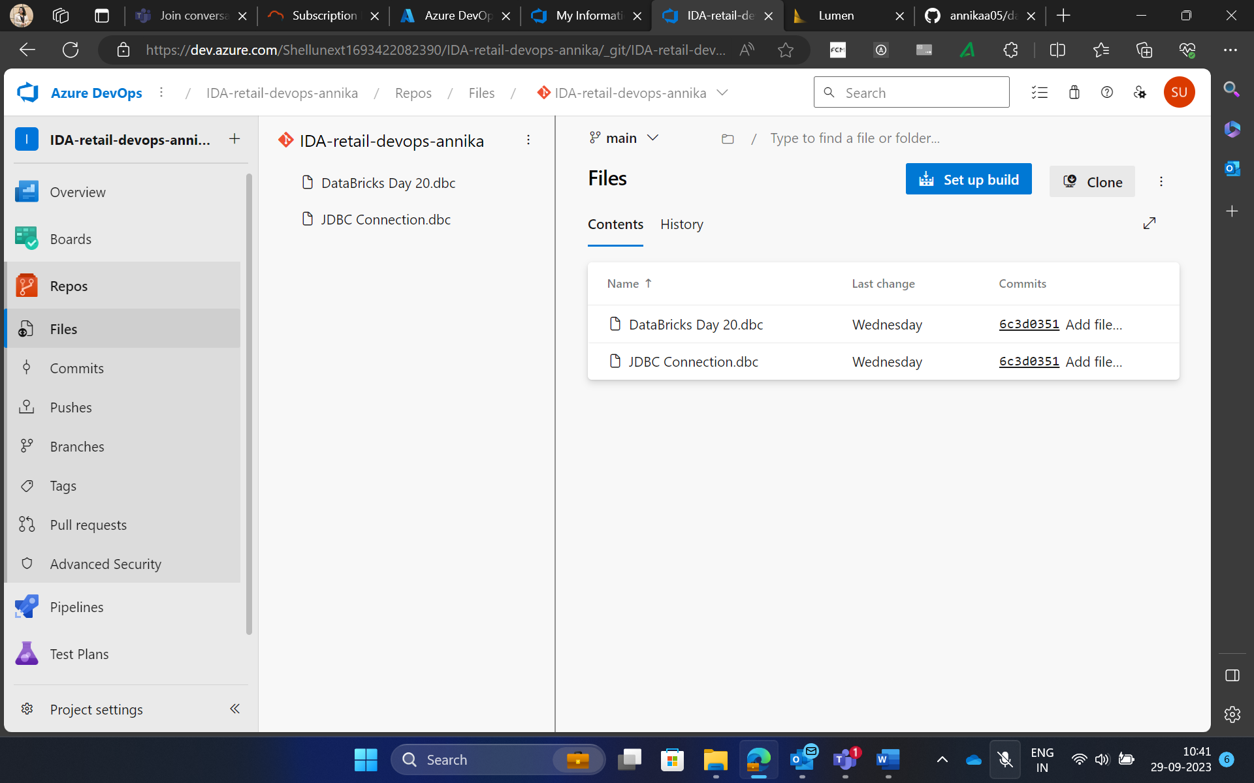
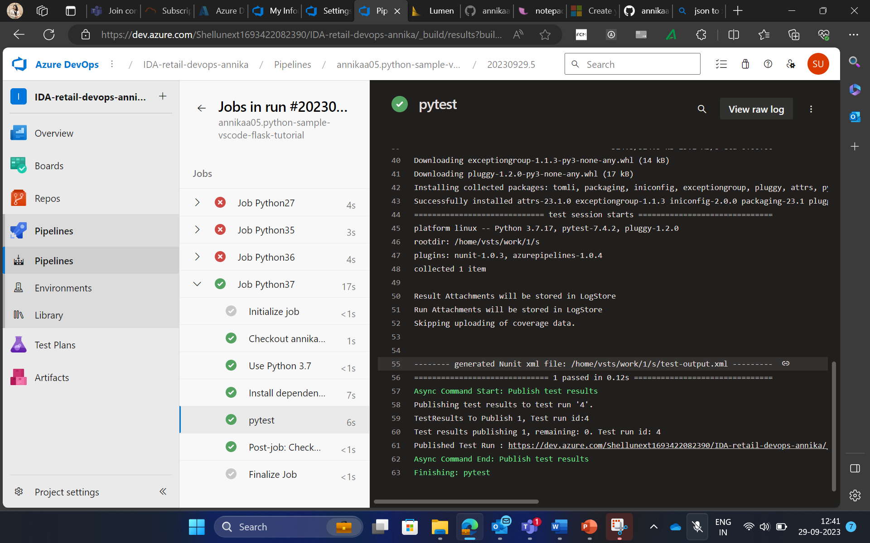
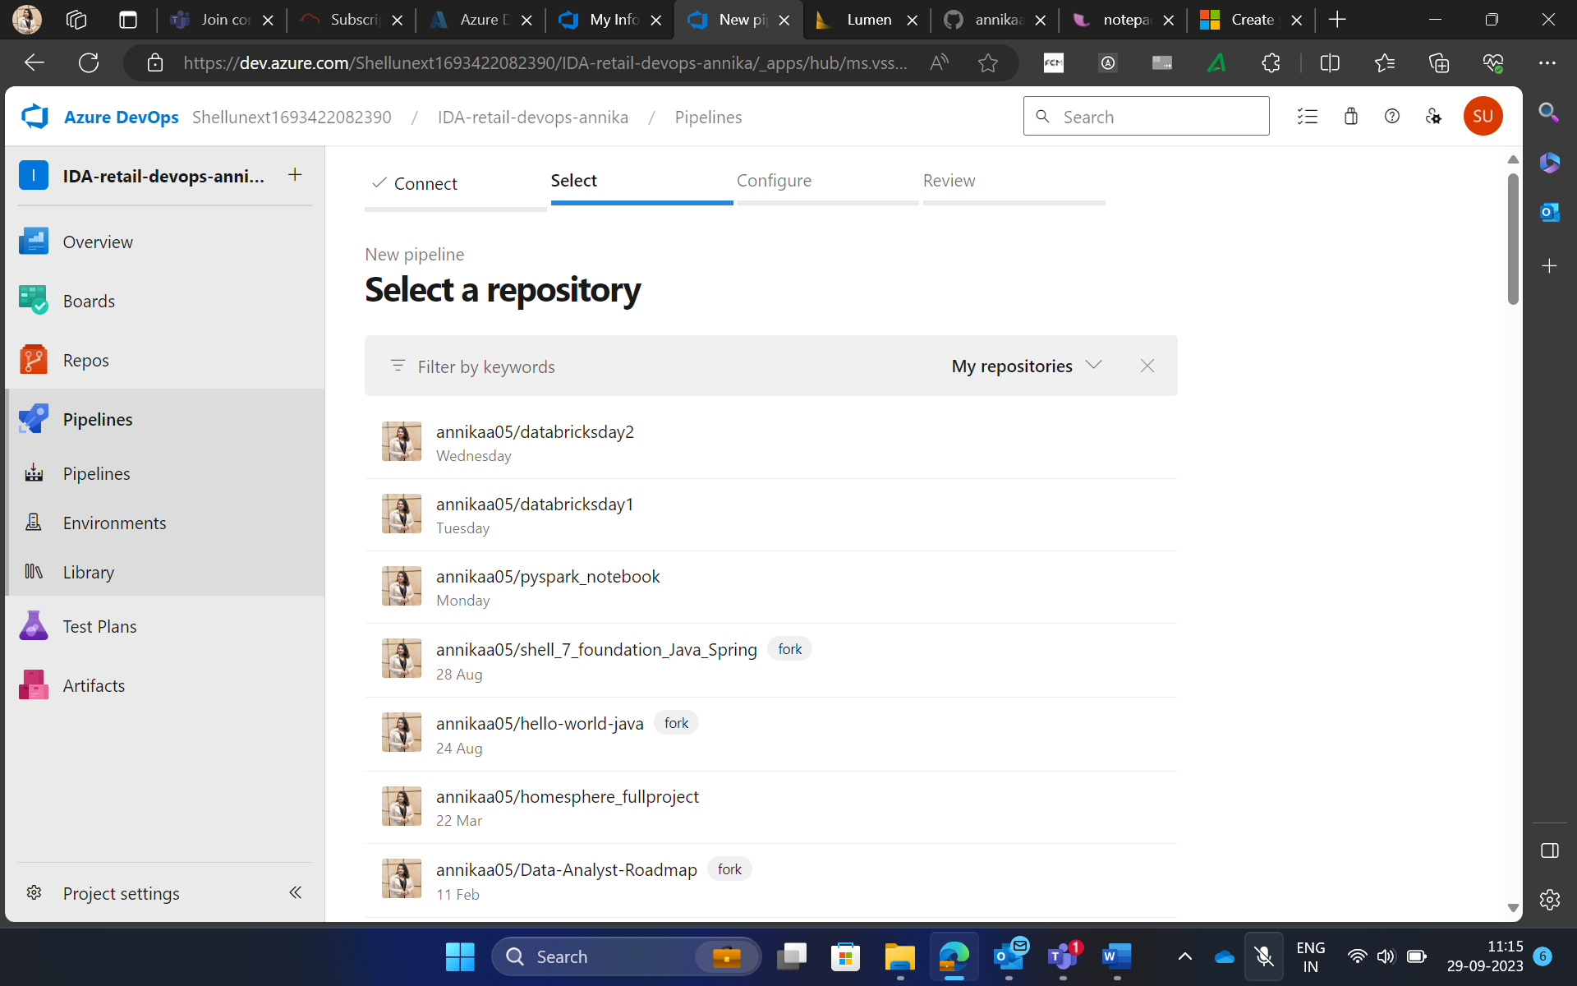

Slide 21
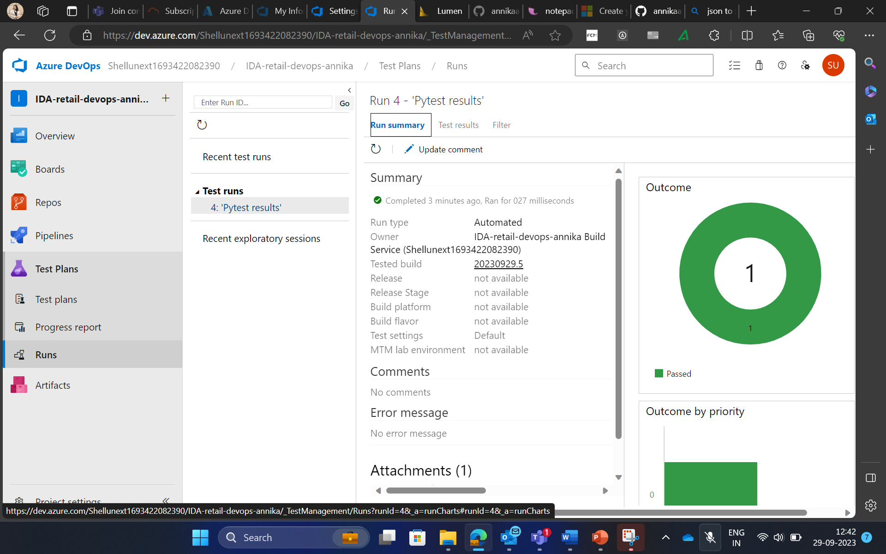

Slide 22
THANK YOU

